Slide 1
Enzymes Part-1
Sem-II (H),Microbio, CBCS System, WBSU

Slide 2
Introduction of Enzymes
Enzymes are proteins that increase the rate of reaction by lowering the energy of activation
• They catalyze nearly all the chemical reactions taking place in the cells of the body.
• Not altered or consumed during reaction.
• Reusable

Slide 3
Apoenzyme & Holoenzyme
The enzyme without its non protein moiety is termed as apoenzyme and it is inactive.
• Holoenzyme is an active enzyme with its non protein component.

Slide 4
Enzymes (from the Greek enzymos, “leavened”) are the chemical catalysts of biological systems. Enzymes have extraordinary catalytic power, often far greater than that of synthetic or inorganic catalysts.
They have a high degree of specificity for their substrates and they accelerate chemical reactions tremendously.
They function in aqueous solutions under very mild conditions of temperature and pH, unlike many catalysts used in organic chemistry.
Enzymes are central to every biochemical process. They catalyze the hundreds of stepwise reactions of metabolism, conserve and transform chemical energy, and make biological macromolecules from simple precursors. In many diseases, the activity of one or more enzymes is abnormal. Many drugs act via binding to enzymes.

Slide 5
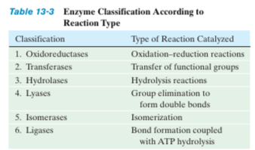

Slide 6
Classification of Enzymes
Enzymes can be classified using a numbering system defined by the Enzyme Commission.
This system consists of a four digit number which classifies based on the type of reaction the enzyme catalyzes.
EC 1. Oxidoreductases– Transfer electrons (Redox reactions)
EC 2. Transferases– Transfer functional groups between molecules
EC3.Hydrolases– BreakbondsbyaddingH2O
EC 4. Lyases– Elimination reactions to form double bonds
EC5.Isomerases– Intramolecular rearrangements
EC6.Ligases– Join molecules with new bonds

Slide 7
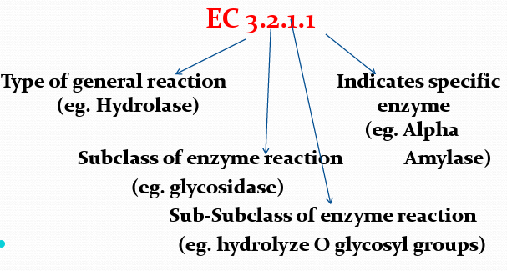

Slide 8
Cofactor:–A cofactor is a non-protein chemical compound that is bound (either tightly or loosely) to an enzyme and is required for catalysis.–Types of Cofactors:
• Coenzymes: The non-protein component, loosely bound to apoenzyme by non-covalent bond. • Examples : vitamins or compound derived from vitamins.
• Prosthetic group: The non-protein component, tightly bound to the apoenzyme by covalent bonds is called a Prosthetic group.

Slide 9
Coenzymes usually act as transient carriers of specific functional groups (Table 6-2). Most are derived from vitamins, which are organic nutrients that are required in small amounts in the diet. Some enzymes require both a coenzyme and one or more metal ions for activity.
A coenzyme or metal ion that is very tightly or even covalently bound to an enzyme protein is called a prosthetic group. A complete, catalytically active enzyme together with its bound coenzyme and/or metal ion is called a holoenzyme. The protein part of such an enzyme is called the apoenzyme or apoprotein. Many enzymes are modified by phosphorylation or other processes. Modifications often are used to regulate enzyme activity.

Slide 10
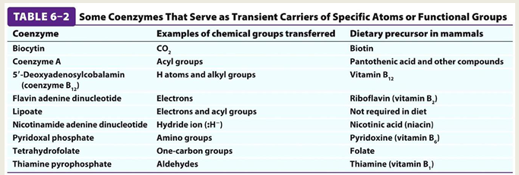

Slide 11
SUBSTRATE SPECIFICITY
The noncovalent forces through which substrates and other molecules bind to enzymes are similar in character to the forces that dictate the conformations of the proteins themselves: Both involve van der Waals, electrostatic, hydrogen bonding, and hydrophobic interactions. Substrate-binding site consists of an indentation or cleft on the surface of an enzyme molecule that is complementary in shape to the substrate (geometric complementarity).
Amino acid residues that form the binding site are arranged to interact specifically with the substrate in an at tractive manner (electronic complementarity). Molecules that differ in shape or functional group distribution from the substrate cannot productively bind to the enzyme; they cannot form enzyme–substrate complexes that lead to the formation of products. The substrate binding site may, in accordance with the lock-and-key hypothesis, exist in the absence of bound substrate or it may, as suggested by the induced-fit hypothesis, form about the substrate as it binds to the enzyme.

Slide 12
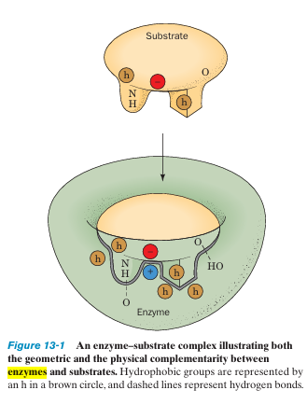
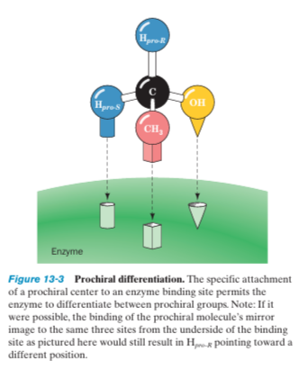

Slide 13
Enzymes are highly specific both in binding chiral substrates and in catalyzing their reactions. This stereospecificity arises because enzymes, by virtue of their inherent chirality (proteins consist of only L-amino acids),form asymmetric active sites. E.g., trypsin readily hydrolyzes polypeptides composed of L-amino acids but not those consisting of D amino acids. Likewise, the enzymes involved with glucose metabolism are specific for D-glucose residues.
Enzymes vary considerably in their degree of geometric specificity. A few enzymes are absolutely specific for only one compound. Most enzymes, however, catalyze the reactions of a small range of related compounds.

Slide 14
Reference:
Biochemistry- Voet & Voet
Molecular Cell biology- Lodish, Darnell
Biochemistry- Stryer

